Slide 1
Application of data warehousing and data mining in Government

Slide 2
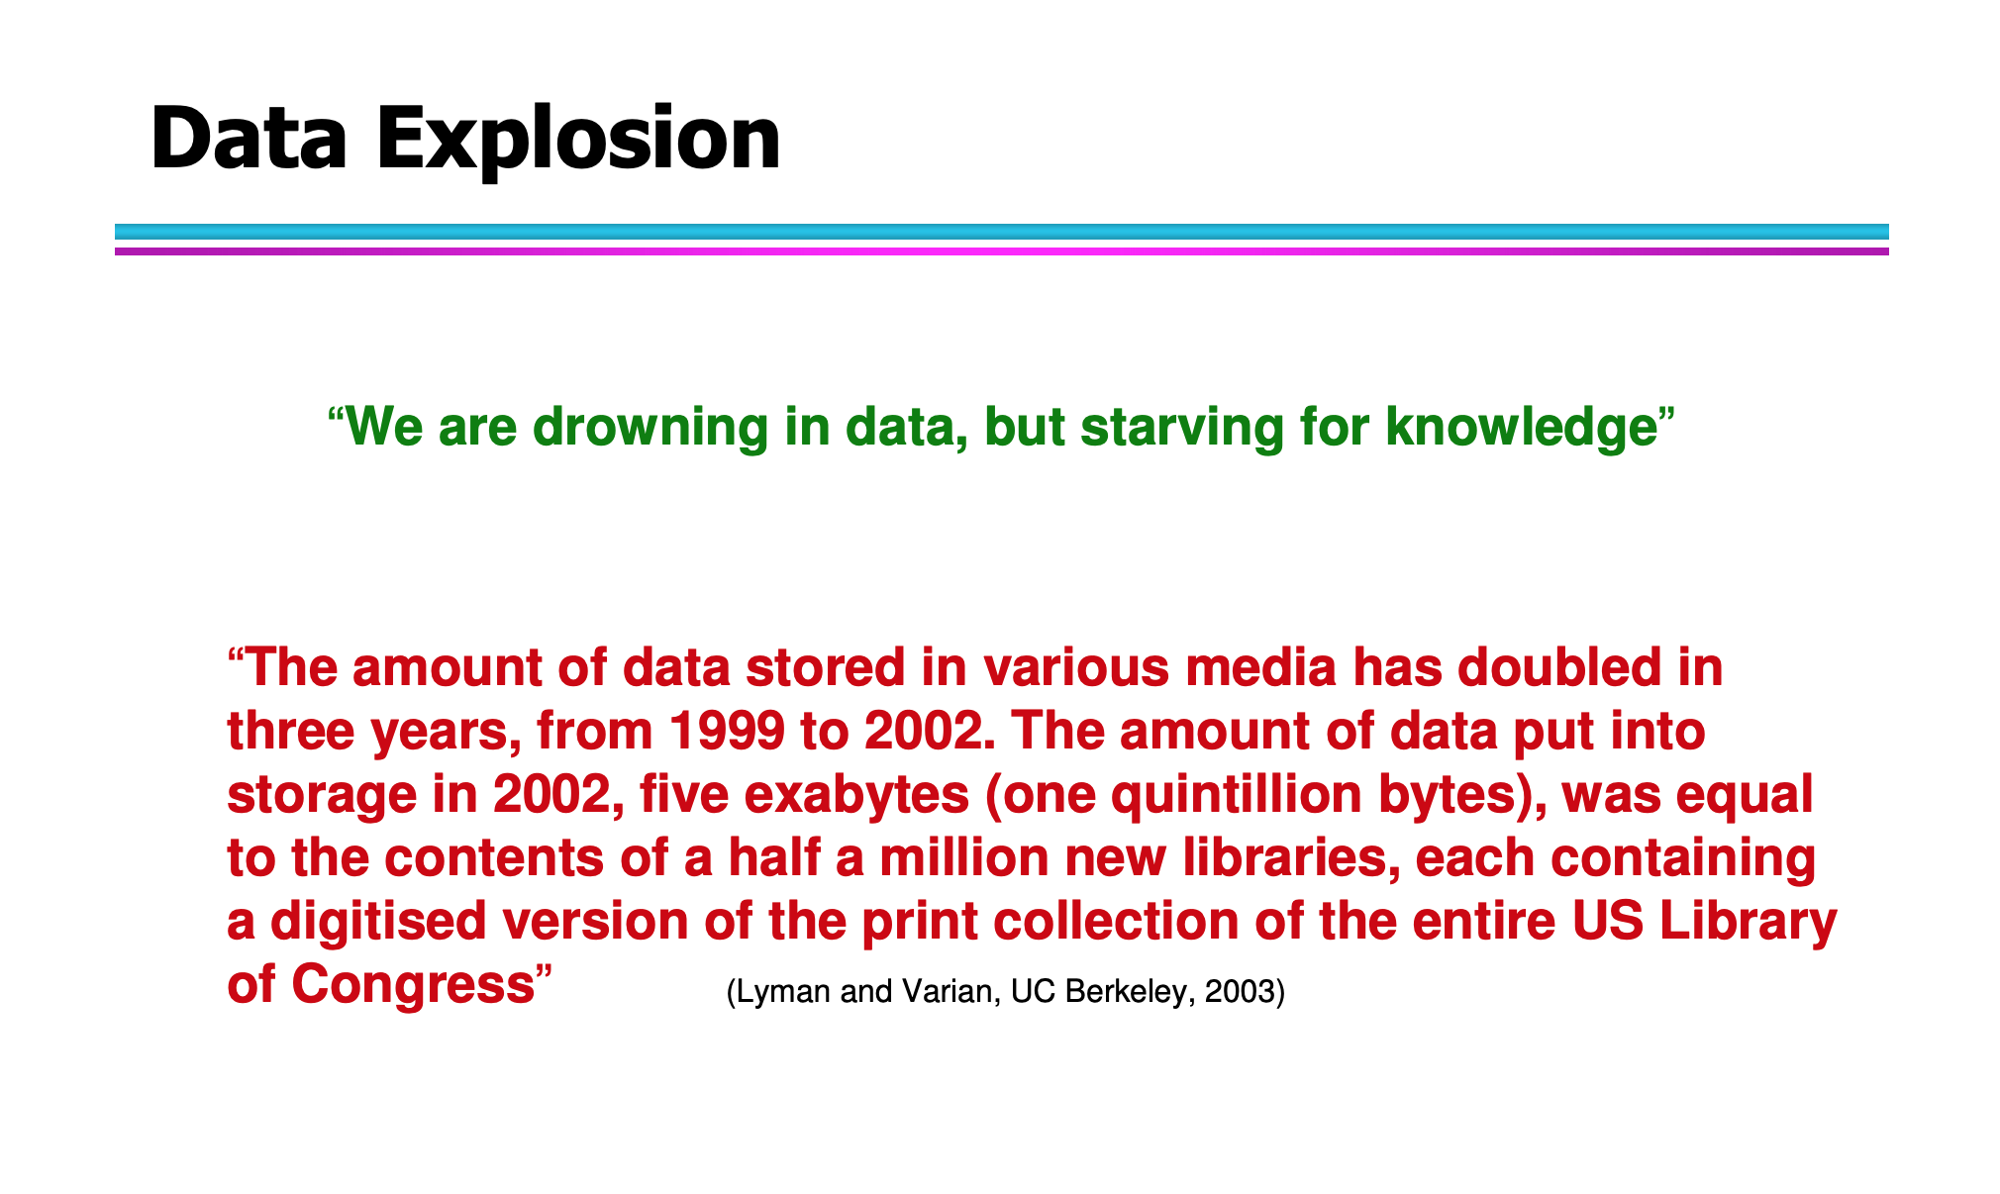
What is Data Mining?

Slide 3
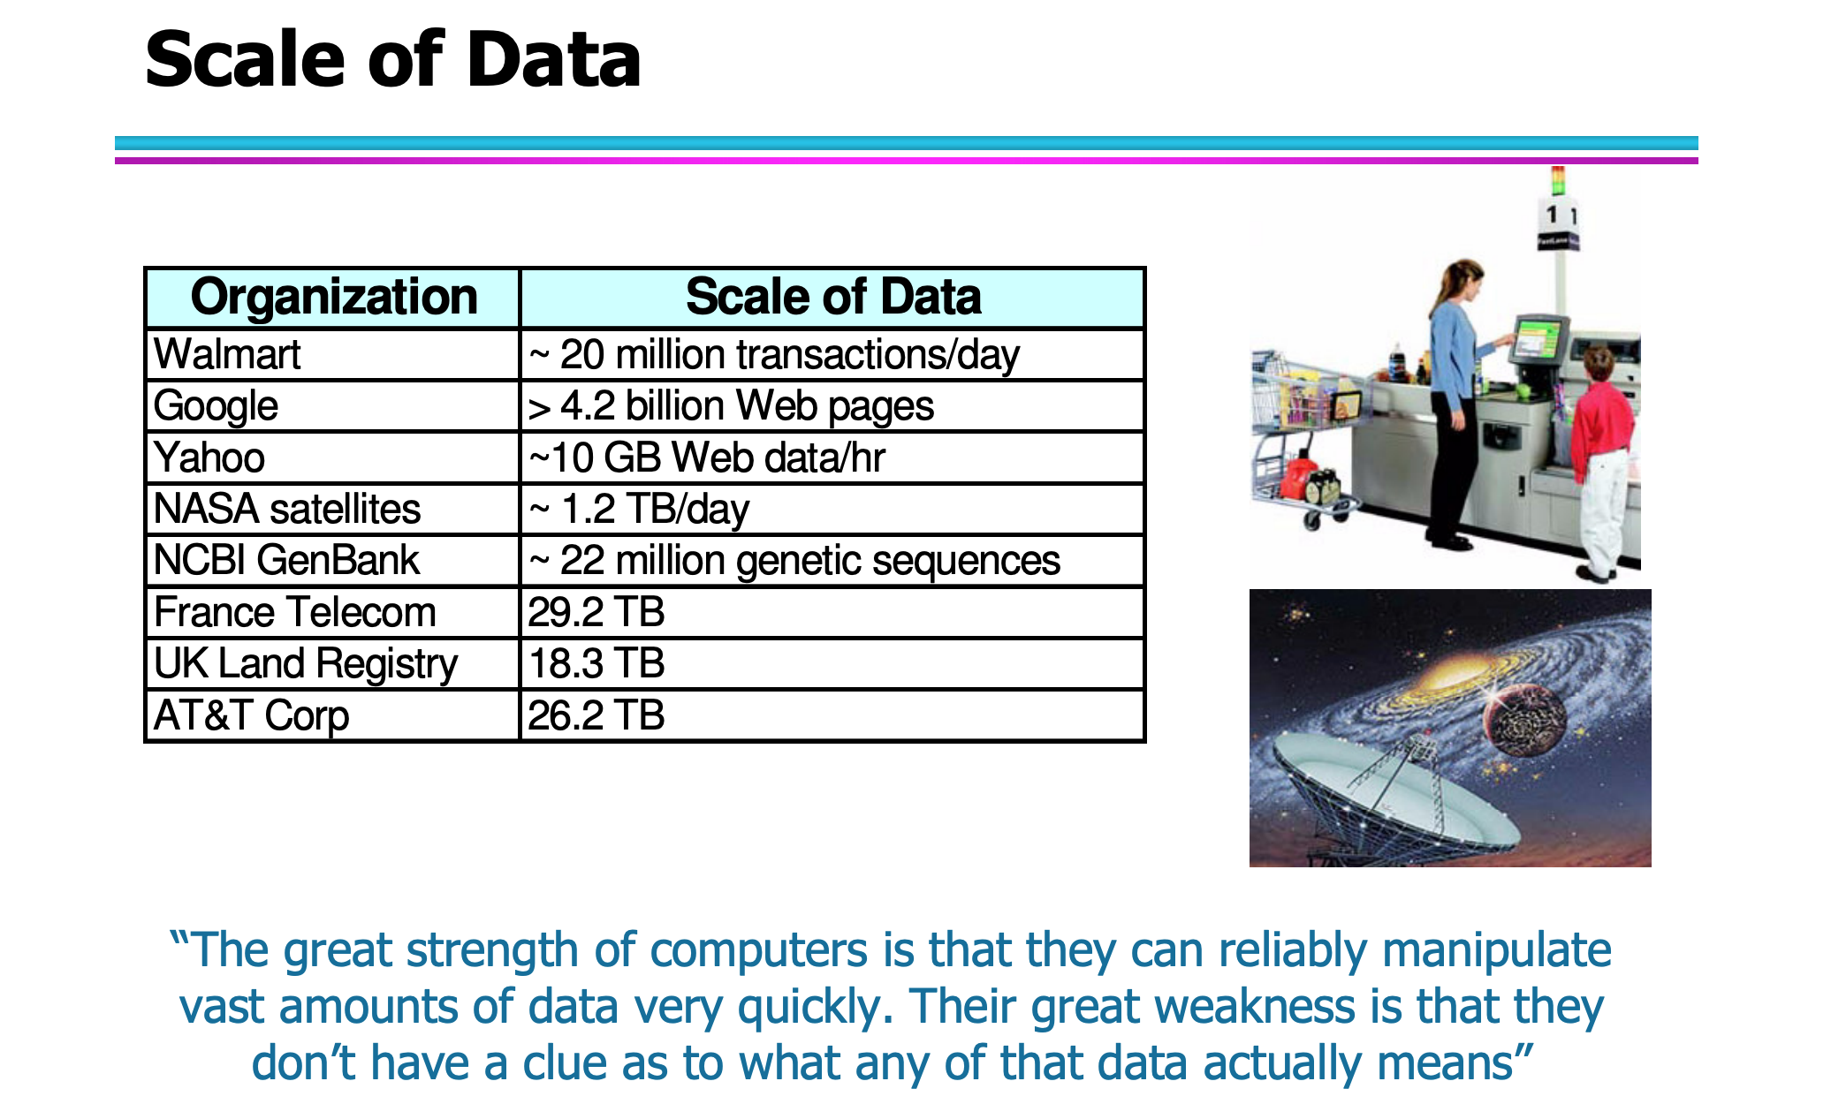
What is Data Mining?

Slide 4
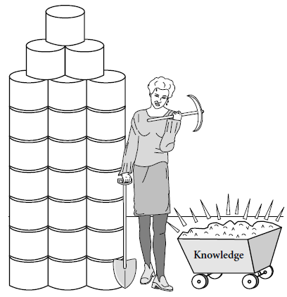
What is Data Mining?
Art/Science of extracting non-trivial, implicit,
previously unknown, valuable, and potentially
Useful information from a large database

Slide 5
Data mining is
A hot buzzword for a class of techniques that find patterns in data
A user-centric, interactive process which leverages analysis technologies and computing power
A group of techniques that find relationships that have not previously been discovered
Not reliant on an existing database
A relatively easy task that requires knowledge of the business problem/subject matter expertise

Slide 6
Data mining is not
Brute-force crunching of bulk data
“Blind” application of algorithms
Going to find relationships where none exist
Presenting data in different ways
A difficult to understand technology requiring an advanced degree in computer science

Slide 7
Data mining is not
A cybernetic magic that will turn your data into gold. It’s the process and result of knowledge discovery, knowledge production and knowledge management.
Once the patterns are found Data Mining process is finished.
Queries to the database are not DM.

Slide 8
Data Warehouse

Slide 9
What is Data Warehouse?
According to W. H. Inmon, a data warehouse is a subject-oriented, integrated, time-variant, nonvolatile collection of data in support of management decisions.
“A data warehouse is a copy of transaction data specifically structured for querying and reporting” – Ralph Kimball
Data Warehousing is the process of building a data warehouse for an organization.
Data Warehousing is a process of transforming data into information and making it available to users in a timely enough manner to make a difference

Slide 10
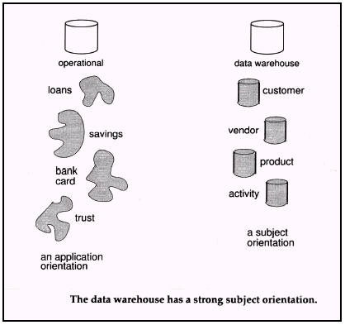
Subject Oriented
Focus is on Subject Areas rather than Applications
Organized around major subjects, such as customer, product, sales.
Provide a simple and concise view around particular subject issues by excluding data that are not useful in the decision support process.

Slide 11
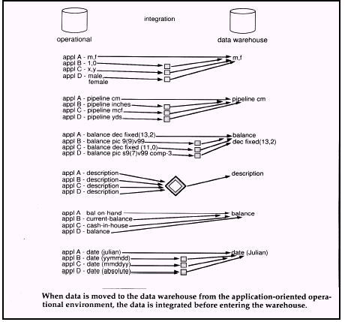
Integrated
Constructed by integrating multiple, heterogeneous data sources
Integration tasks handles naming conventions, physical attributes of data
Must be made consistent.

Slide 12
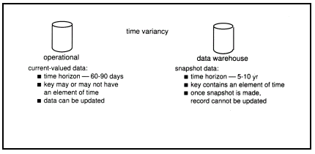
Time Variant
Only accurate and valid at some point in time or over some time interval.
The time horizon for the data warehouse is significantly longer than that of operational systems.
Operational database provides current value data.
Data warehouse data provide information from a historical perspective (e.g., past 5-10 years)

Slide 13
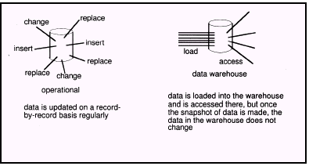
Non Volatile
Data Warehouse is relatively Static in nature.
Not updated in real-time but data in the data warehouse is loaded and refreshed from operational systems, it is not updated by end users.

Slide 14
Data warehousing helps business managers to :
Extract data from various source systems on different platforms
Transform huge data volumes into meaningful information
Analyze integrated data across multiple business dimensions
Provide access of the analyzed information to the business users anytime anywhere

Slide 15
Why Data Mining?
Because it can improve customer service, better target marketing campaigns, identify high-risk clients, and improve production processes. In short, because it can help you or your company make or save money.
Data mining has been used to:
Identify unexpected shopping patterns in supermarkets.
Optimize website profitability by making appropriate offers to each visitor.
Predict customer response rates in marketing campaigns.
Defining new customer groups for marketing purposes.
Predict customer defections: which customers are likely to switch to an alternative supplier in the near future.
Distinguish between profitable and unprofitable customers.
Identify suspicious (unusual) behavior, as part of a fraud detection process.

Slide 16
Data analysis and decision support
Market analysis and management
Target marketing, customer relationship management (CRM), market basket analysis, cross selling, market segmentation
Risk analysis and management
Forecasting, customer retention, improved underwriting, quality control, competitive analysis
Fraud detection and detection of unusual patterns (outliers)

Slide 17
Benefits of Data Warehousing
Queries do not impact Operational systems
Provides quick response to queries for reporting
Enables Subject Area Orientation
Integrates data from multiple, diverse sources
Enables multiple interpretations of same data by different users or groups
Provides thorough analysis of data over a period of time
Accuracy of Operational systems can be checked
Provides analysis capabilities to decision makers

Slide 18
Increase customer profitability (Potential high returns on investment)
Cost effective decision making(Increased productivity of corporate decision-makers)
Manage customer and business partner relationships
Manage risk, assets and liabilities
Integrate inventory, operations and manufacturing
Reduction in time to locate, access, and analyze information (Link multiple locations and geographies)
Identify developing trends and reduce time to market analysis
Strategic advantage over competitors(t allows a business to more effectively strategize and execute against other vendors in its sector.)

Slide 19
Provide reliable, High performance access
Consistent view of Data: Same query, same data. All users should be warned if data load has not come in.
Quality of data is a driver for business re-engineering.
Enables Historical Insight
(a data warehouse can add context to this historical data by listing all the key performance trends that surround this retrospective research.)

Slide 20
Advantages of Data Mining
Automated prediction of trends and behaviors:
Data mining automates the process of finding predictive information in large databases. Questions that traditionally required extensive hands-on analysis can now be answered directly from the data quickly.
Automated Discovery of previously unknown patterns:
Data mining tools sweep through databases and identify previously hidden patterns in one step.

Slide 21
Dataware housing and E-governance (Nepal)
With the extensive application of various E-government systems, information sharing in different government organizations for the Decision Support System (DSS for E-government) is required urgently.
How to construct an effective data platform to provide support for government decision-making is a complicated matter.
So, any successful plan and idea in only one ministry, it won't be shared with others even if the government use more computerized and networked between their departments by internet and mail that makes the information available in one ministry, and might not be obtainable to another ministry that means there is independency.
the main issue in government organizations of Nepal is the information is highly centralized.
using a data warehouse platform to merge the government organizations' databases in one common warehouse with E-government technologies, which increases the sharing of information among the different department itself and with other organizations’ departments.
Thus we are in essence of a National Dataware house

Slide 22
Data Mining and Data warehousing in E-government
Governments deal with large amount of data. To ensure that such data is put to an effective use in facilitating decision making, a data warehouse and Data Mining techniques are used over the historical data.
It permits several types of queries requiring complex analysis on data to be addressed by decision makers.
focus is on the scope and use of Data Warehousing & Data Mining in all the dimensions of EGovernance like Government to Citizen (G2C), Government to Government (G2G) and Government to Business (G2B).
The efficiency of Government can be increased by using the Data Warehouses and Data Mining.

Slide 23
National Data warehouse
In the government there are huge data produced and stored independently by individual minisitry and are not exchanged between them
information is typically scattered in space and time, large areas are usually unmonitored and the data collected is often at different quality levels depending on the (part of the) network they represent
the efficiency of the decisions strongly depends on how accurate, reliable and timely is the data can be gathered
using a data warehouse platform to merge the government organizations' databases in one common warehouse with E-government technologies
A large number of national warehouse can be identified from the existing resources within the central government ministries
Let us examine the potential subject areas on which data warehouse can be developed

Slide 24
National Data Warehouse
Census data:-
A database can be developed based on census data eg, information of all individuals, village population groups etc,
Data warehouse can be developed from the database upon which OLAP techniques can be applied
Data mining also can be performed for analysis and knowledge discovery

Slide 25
National Data Warehouse
Census data:-
Data warehouse from census data enables multi dimensional analysis of the village/population data in various section such as education , Health and Infrastructure
The census data compilation is performed in once in ten years(eg)
No refreshing of the data needs to be done on a period basis .
Only new data to be either appended to data ware house or alternatively new database can be built

Slide 26
National Data Warehouse
Price of Essential Commodities:-
The government (ministry of food and civil supplies for eg) compiles daily data for the observation centers in the entire country on prices of essential commodities such as rice, edible oils, etc.
These data are compiled and data warehouse is developed by respective authority/organization
OLAP can be applied for its analysis
A data mining and forecasting technique can be applied for advance forecasting of the actual prices of these essential commodities
The forecasting model can be strengthened for more accurate forecasting by taking into account the external factors such as rainfall, growth rate of population , inflation etc

Slide 27
Application of data warehousing and data mining in government
Agriculture :
Compiles a large number of the agricultural parameters at national level to build data ware housing, eg
Production; Consumption; Agricultural Marketing; Fertilizer Consumption; Seeds; Prices (wholesales & retail); Technology; Agricultural census; Marketing region(s); Live stock; Crops; Agricultural credit; Plant Protection; Watershed; Area under Productions yields; Land use statistics; Finance & Budget etc.
Dataware house then used for analysis, mining and forecasting
OLAP also used for multidimensional analysis
Data marts can be created if we want to be specific on particular parameters eg, statistic on consumption of fertilizers
Petroleum & Natural Gas:
Marking; Finance; Personnel; Pricing; Import; Crude & Product Production; Sale - from Oil Corporations.

Slide 28
Application of data warehousing and data mining in government
Tourism:
Foreign Tourist Arrival System (FTAS); Customer preference/behaviour Data base; Tourism & Product Development Information; Foreign Exchange earning; Employment Opportunities; Manpower & Training; Marketing Research; Publicity; Hotel Classification System; Travel & Tour Operators data base.
Rural Development :
Below Poverty line; Drinking Water; Rural Population - census; Rural Development scheme of the state & Central govt.; per capital income - Rural, Urban;

Slide 29
Application of data warehousing and data mining in government
Health & Family Welfare:
Health & Family Welfare MIS; Community needs Assessment Approach: Immunization (mother & child health); External Aid monitoring; National Programme for Control of Blindness (NPCB); National Leprosy Eradication (NLEP); National Malaria Eradication (NMEP); National Aids Control; Drug policy; Health law; Morbidity & Mortatility pattern; Medical Record System (Hospital); Stores; Medical & Para medical manpower; NGO data base; Emergency Medical Relief; Health Education; census etc.

Slide 30
Application of data warehousing and data mining in government
Planning Commission:
State Plans (All sectors); Labor; Health; Education; Trade; Industry; Annual Budget; Five Year Plans; State Plan Project; Rural Development; Energy including Non-conventional.
Commerce:
Import & Export (Trade); E-Commerce; Exports & Imports data bank ; Foreign Trade (Principal Commodities and counties); Trade Policy; Balance of Payment; World Price monitoring system; Provisional Estimates of Import & Export.

Slide 31
Application of data warehousing and data mining in government
Revenue:
Custom data, central excise data, commercial taxes data
Economic affairs:-
Budget and expenditure data: and annual economic survey
Audit and accounts :-
Government accounts data

